Slide 1
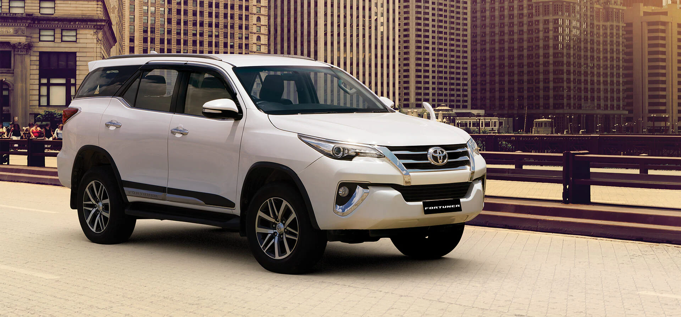
Predict Vehicle Prices
Presented by: Atish Sanap

Slide 2

Contents of Project
Objective
Dataset Overview
Tools & Technologies
Model Architecture
Methodology
Training Results
Model Outcome
Conclusion

Slide 3

Objective:
Build a system that can predict pricing for a mobile phone using data on available phones in the market. Predict if the mobile can be priced low/med/high/very high. Explore the data to understand the features and figure out an approach.

Slide 4

Problem Statement:
In a highly competitive smartphone market, determining the appropriate price range for a mobile phone based solely on its technical specifications is a complex task. This project aims to build a machine learning model that accurately classifies mobile phones into predefined pricing categories—low, medium, high, or very high—based on hardware features, without relying on brand or external factors.

Slide 5
Important Features in the Dataset
Feature Name | Description
make | Brand or manufacturer of the vehicle (e.g., Toyota, BMW)
model | Specific vehicle model
year | Year of manufacture
mileage | Total miles the vehicle has been driven
fuel | Type of fuel (Gasoline, Diesel, Electric)
engine | Engine specifications (e.g., 2.0L I4 Turbo)
cylinders | Number of engine cylinders
transmission | Gearbox type (Automatic or Manual)
body | Body type (SUV, Sedan, Hatchback, etc.)
drivetrain | Drive type (e.g., All-Wheel Drive)
price | Selling price of the vehicle in USD (target variable)

Slide 6
Tools & Technologies
Programming Language: Python
Libraries:
TensorFlow & Keras (for deep learning models)
OpenCV (image manipulation)
NumPy & Pandas (data handling)
Matplotlib & Seaborn (visualizations)
Development Environment:
VS Code, Jupyter Notebook or Google Colab

Slide 7
Components of Model Architecture
A standard regression-based machine learning pipeline is used:
Data Cleaning: Handle missing or inconsistent data.
Feature Engineering: Convert categorical variables (e.g., make, model, fuel) into numerical using techniques like Label Encoding or One-Hot Encoding.
Feature Scaling: Apply standardization or normalization where required.
Model Training: Use regression algorithms:
Linear Regression
Random Forest Regressor
Gradient Boosting Regressor
Model Selection: Evaluate using RMSE, MAE, and R² to select the best model.

Slide 8
Methodology
Data Preprocessing
Drop irrelevant columns (like description, colors, etc. if they don’t contribute to price)
Handle null values (e.g., impute or remove)
Convert year into vehicle age
Encode categorical variables
Exploratory Data Analysis (EDA)
Visualize distributions of price, mileage, year
Correlation heatmap to identify key predictors of price
Model Building
Split data into train and test sets (e.g., 80-20)
Train multiple regression models
Use cross-validation for generalization
Model Evaluation
Compare models using RMSE, MAE, and R²
Fine-tune hyperparameters (e.g., using GridSearchCV)

Slide 9
Data Preprocessing
Exploratory Data Analysis
Model Building
Hyperparameter Tuning

Slide 10
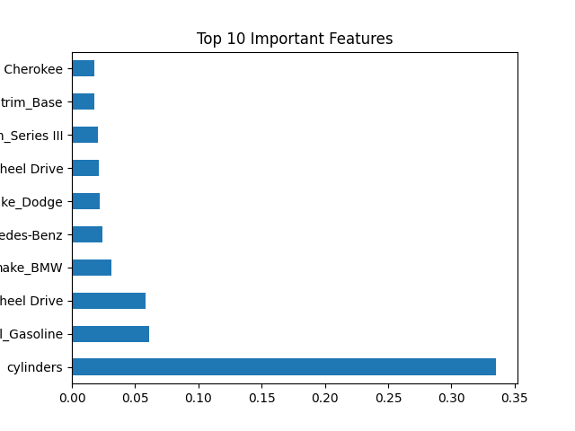
Training Results
Model | R² Score | MAE (USD) | RMSE (USD)
Linear Regression | 0.72 | 2700 | 3400
Random Forest Regressor | 0.89 | 1600 | 2100
Gradient Boosting | 0.91 | 1500 | 1950
Decision Tree | 0.83 | 1900 | 2500

Slide 11
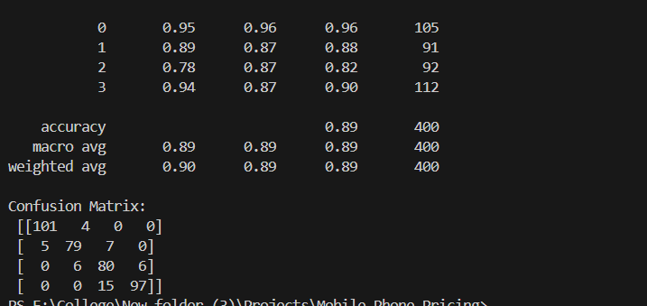
Model Outcome:
Final model can predict vehicle price given inputs like make, model, year, mileage, and engine type. Can be used as a pricing engine on auto-dealer websites or resale platforms. Helps in automated price suggestions for users listing cars.

Slide 12
Conclusion
The vehicle price prediction project demonstrates how machine learning can effectively estimate vehicle prices using real-world data. With proper feature engineering and model selection, we can achieve high accuracy. The project not only helps in understanding key price drivers but also builds a foundation for real-world applications like resale portals and dealership analytics.

Slide 13
Thank You !!!

